Slide 1
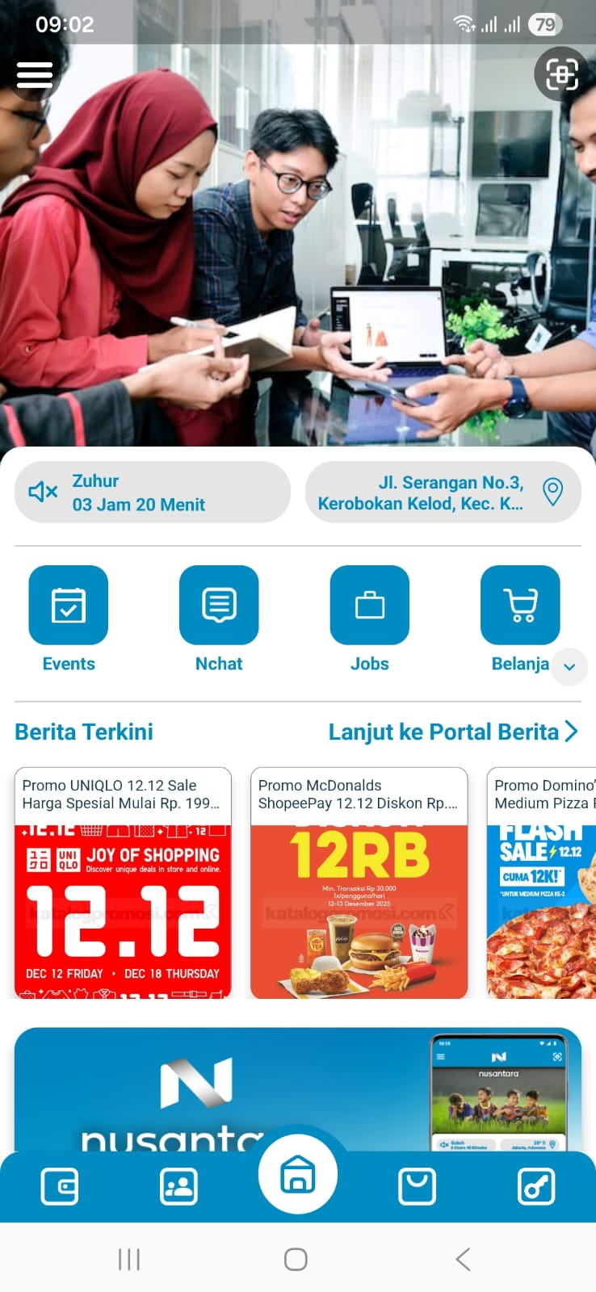
The News Portal button is not frequently used, we could use it for marketplace shortcuts/influencers links, etc.
We could make the ‘Berita Terkini’ button as a link to go to News portal.

Slide 2
The expand button is not too visible, please make it bigger and/or different color.

Slide 3
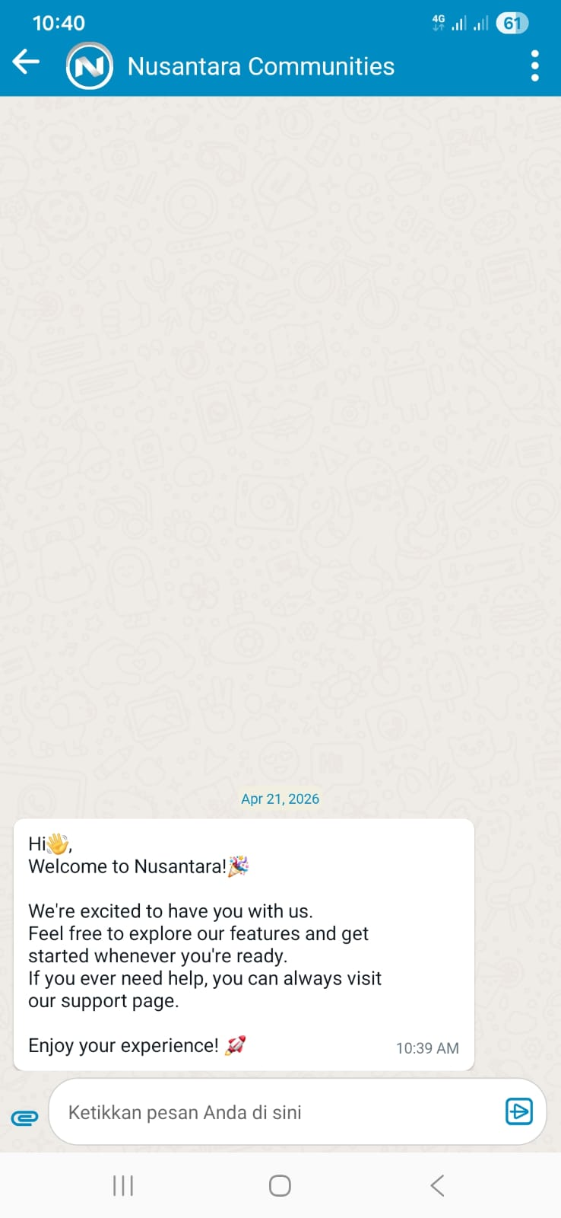
Please make it linked to support page

Slide 4
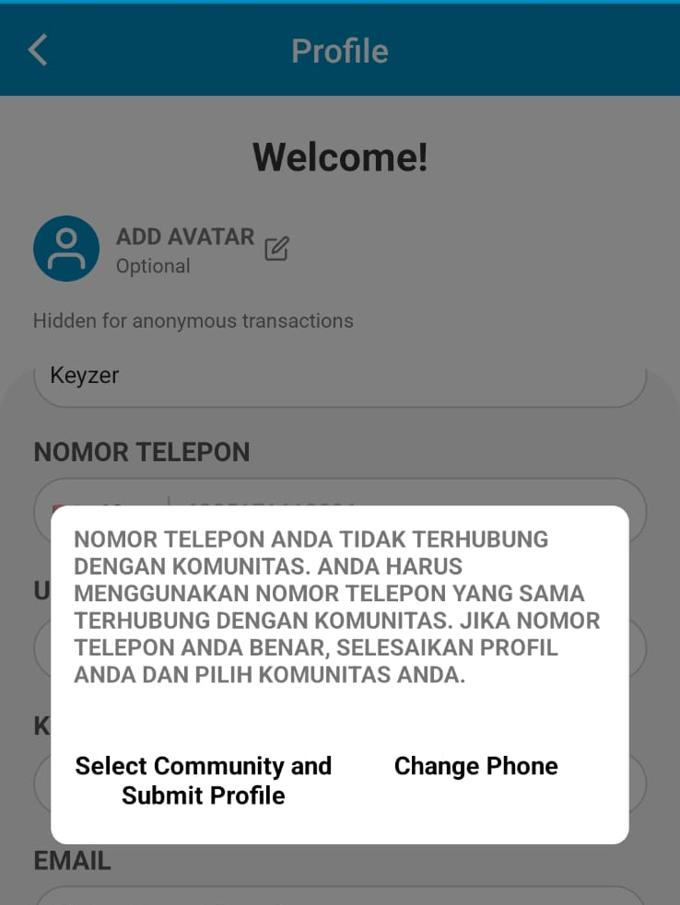
Current
Proposed
Nomor yang kamu gunakan belum terhubung dengan komunitas apapun. Silahkan pilih komunitasmu!
Change phone number

Slide 5
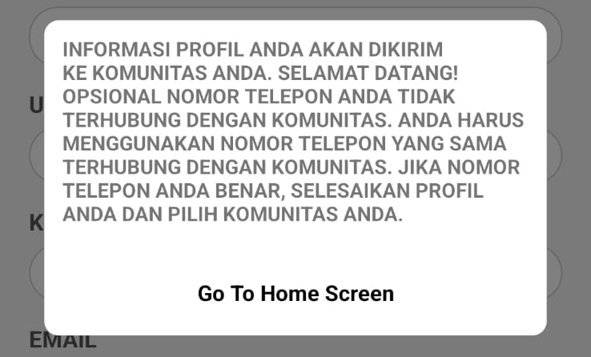
This could be removed, the info about connected numbers could use the one in the previous slide.

